Slide 1

नेपथ्य
GUIDING DIRECTION
New country, new job, new life. One call away.
Presented By : Ximeki

Slide 2
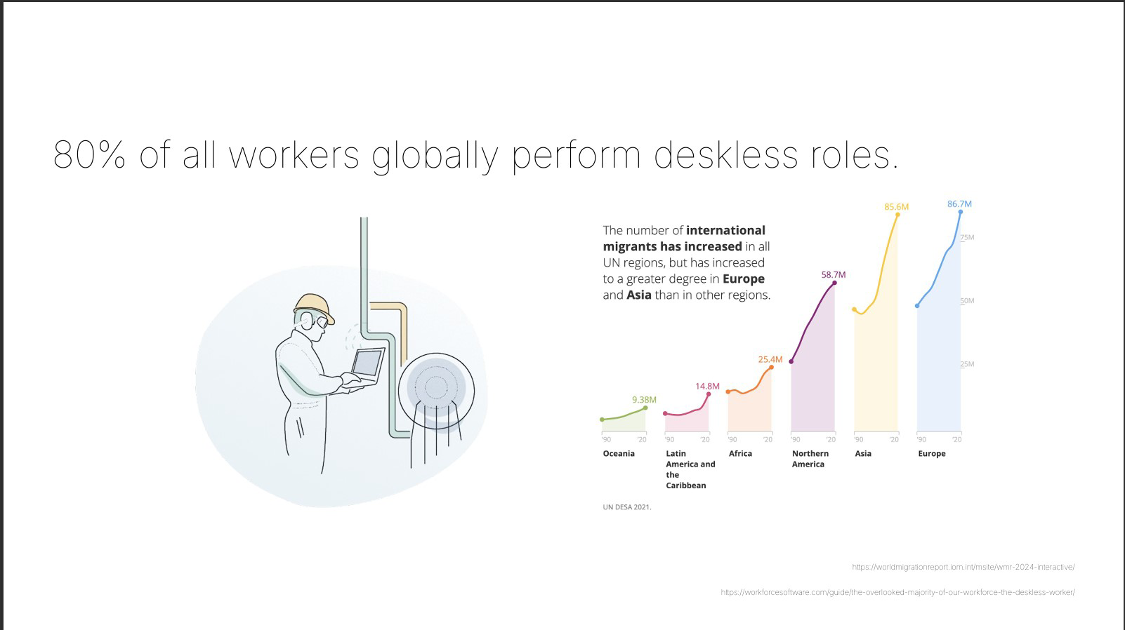

Slide 3
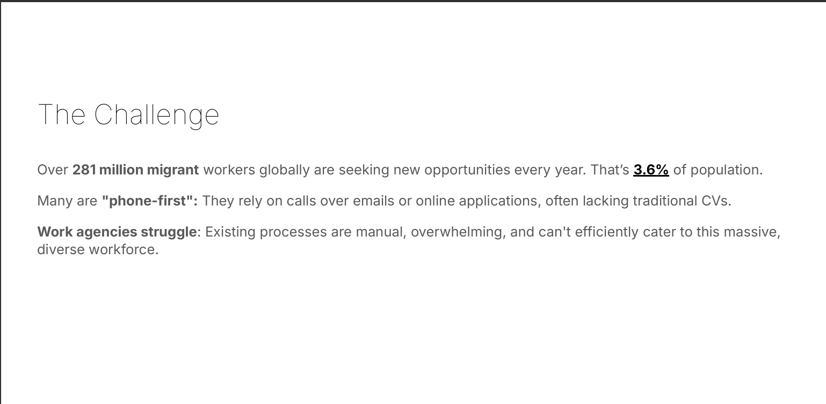

Slide 4
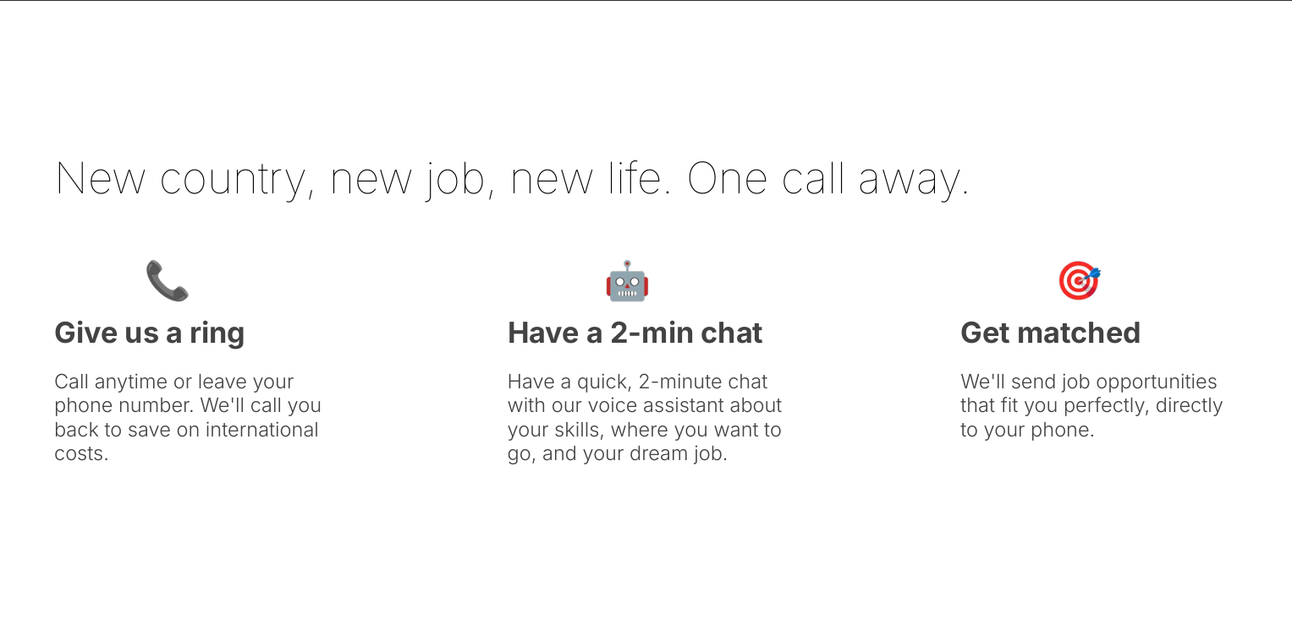

Slide 5
Its like a recuirter and assistant that works 24/7 speaks many
different laungauages and browse thousands of jobs

Slide 6
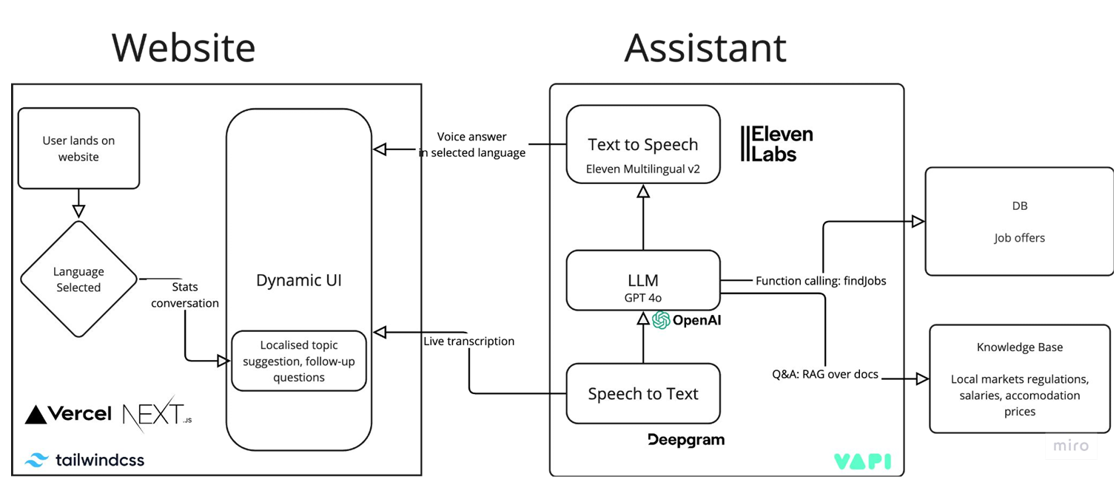

Slide 7
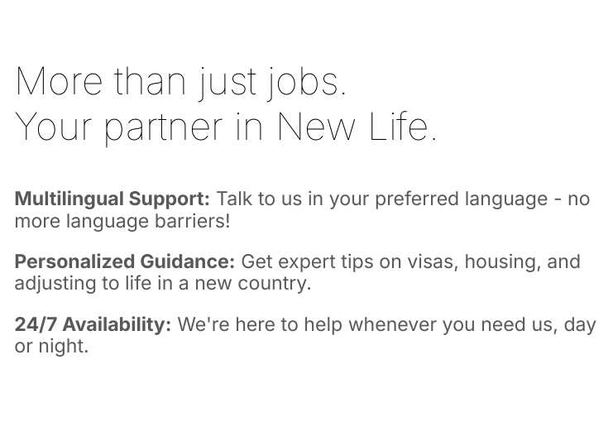

Slide 8
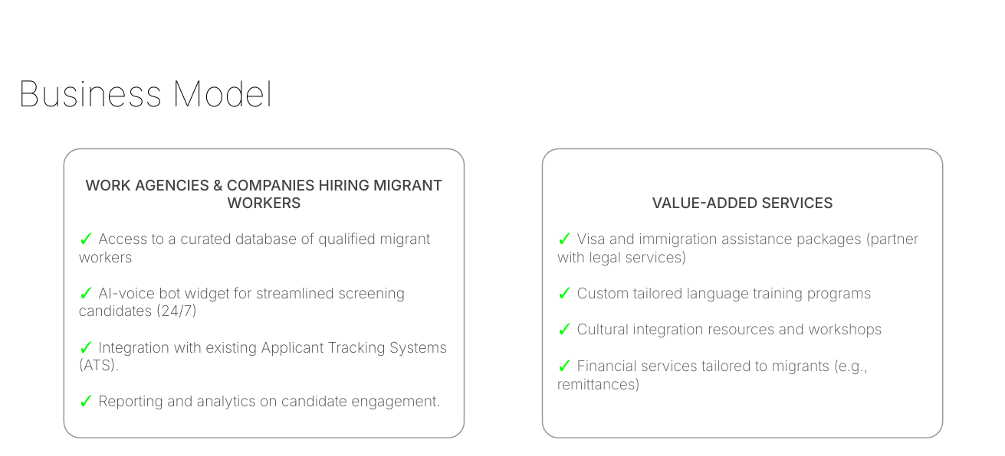

Slide 9
THANK YOU

